Slide 1

Bank Marketing
(Campaign)
Virtual Internship
14-Aug-2021

Slide 2
GROUP MEMBERS
1. William Ogweli Okomba, willokomba@gmail.com, Kenya
2. Ece Kurnaz, eceeee.kurnaz@gmail.com, Turkey
3. Colin Mburugu, colinmburugu@gmail.com, Kenya
4. Udbhav Balaji, udbhavbalaji@gmail.com, India

Slide 3
Background
ABC bank (a Portuguese banking institution) has a term deposit product that is desired to be sold to clients.
Focussing on customer's past interactions with the bank or other financial institutions to have a better understanding on whether these particular clients will buy this product or not.
With the customer’s data, we can get some insights about the customer that will help in decision making to determine whether the customer will buy the product or not.

Slide 4
Data Exploration
21 Features in total.10 numeric features and 11 categorical features
Time frame of the data: May 2008 to November 2010
Total data points :41188 records

Slide 5
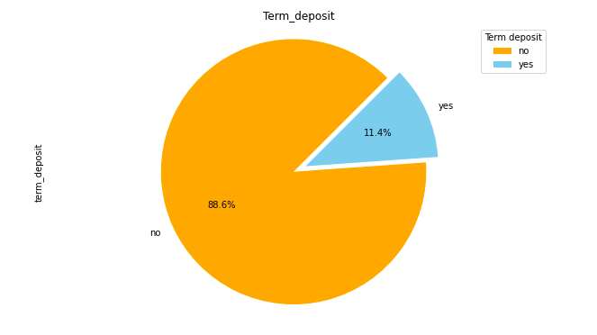
Target Variable Analysis
Profit Analysis
From the pie chart, we see that from the campaign conducted, 11.4% would subscribe to the product and the remaining 88.6% wouldn’t.

Slide 6
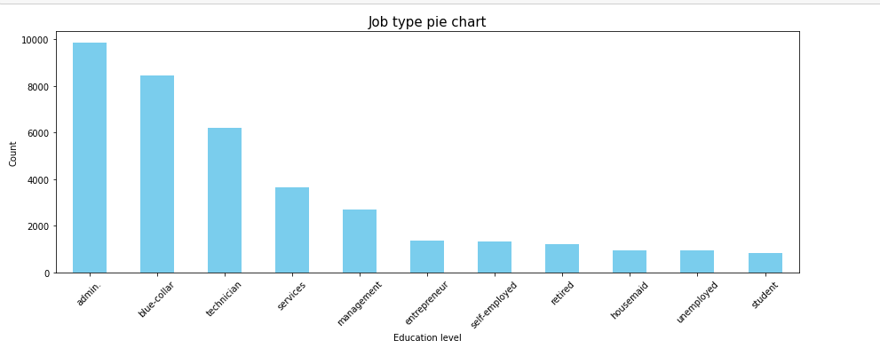
Job Type Analysis
The bank contacted mostly the admins and the students were least contacted people.

Slide 7
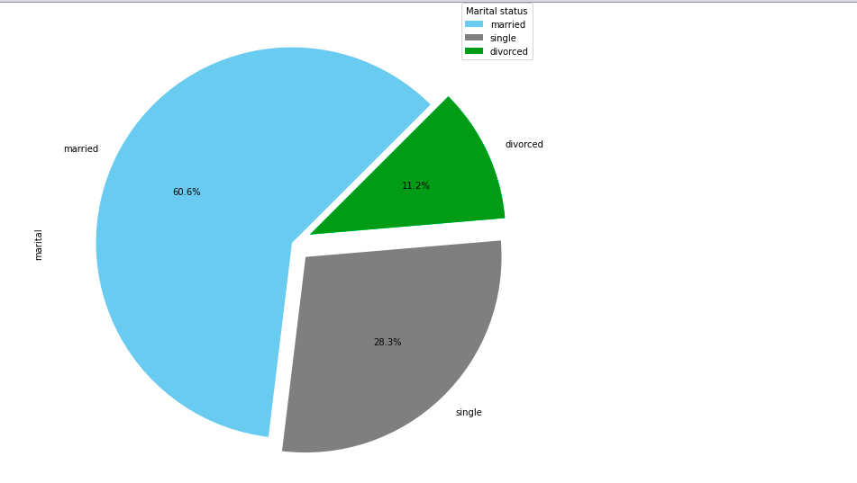
Marital status Variable
60.6% of the customers contacted during the campaign are married.11.2% are divorced and 28.3% are single.
So married people were the mostly contacted during that campaign.

Slide 8
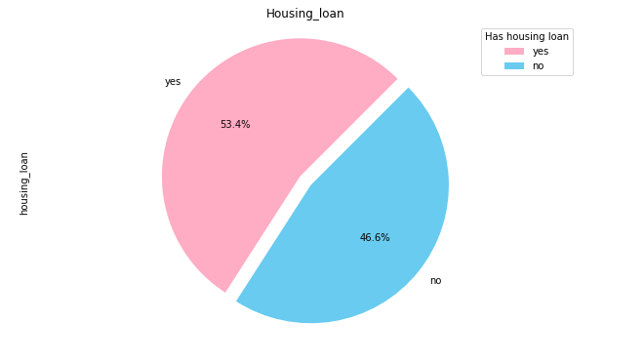
House Loan Variable Analysis
The variable answers whether the respondent has a house loan or not.
From the pie chart, 53.4% have a house loan and the remaining 46.6% don’t have a house loan

Slide 9
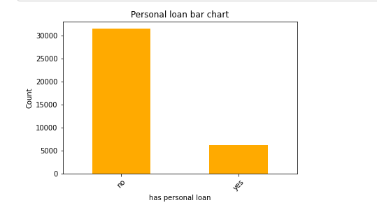
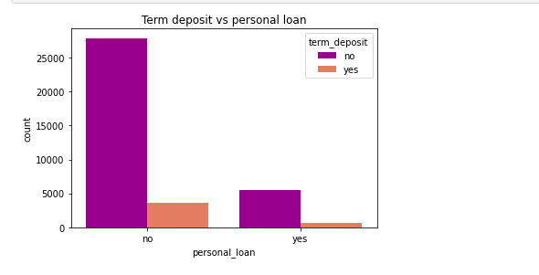
Personal Loan Variable Analysis
Those with no personal loans are more than the ones with personal loans. Still the ones with no personal loans agreed to buy the bank’s product more than the ones with personal loans.

Slide 10
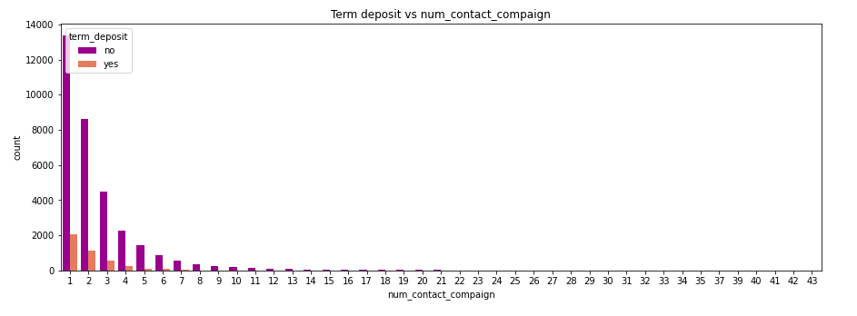
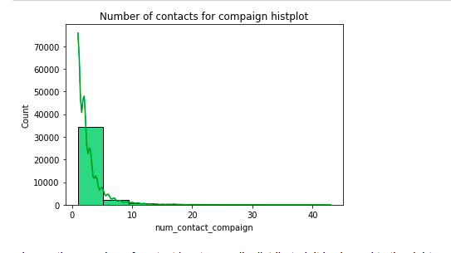
Number of Contacts Analysis
From the hist plot we see that most respondents were contacted between 1 and 5 times.
A little of them between 5 and 10 times and very few above ten times.
Most of the respondents who agreed to buy the bank’s product were contacted only once. As the number of contact increases, so does the chances of the customer buying the product lower.

Slide 11
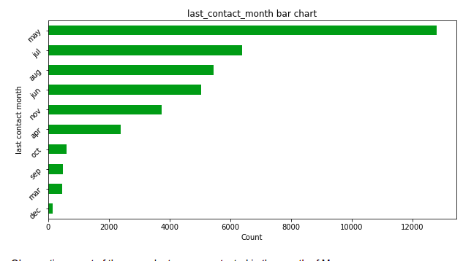
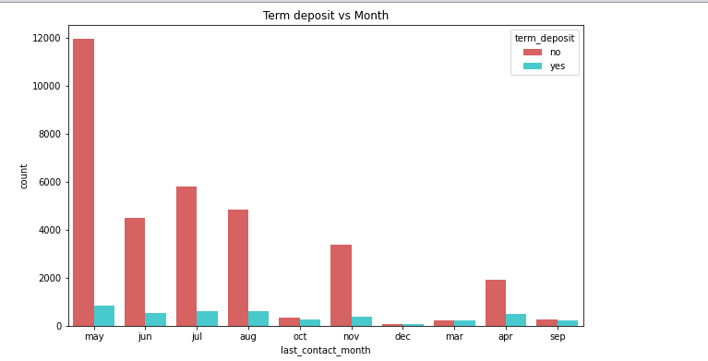
Last_Contact_Month Analysis
The months of May, July, August and June are the months which most respondents were reached. It is in the same months that most customers agreed to buy the bank’s product.
The month of December had the least number of customers reached, still the same month that had least customers accepting to buy the bank’s product.

Slide 12
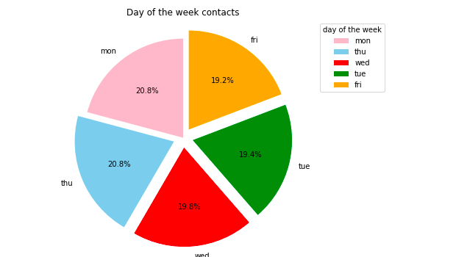
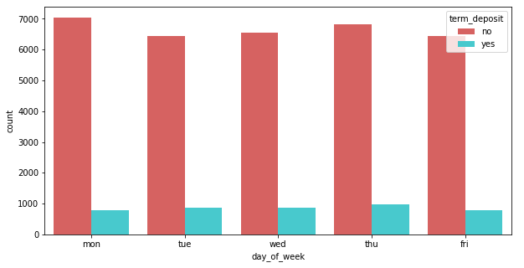
Day Of The Week Contacted Analysis
Most respondents were contacted on Mondays and Thursdays. Despite that, the number of people who agree to buy the term deposit is almost the same in all days thus the day of contact not contributing much to whether the customer will buy the product.

Slide 13
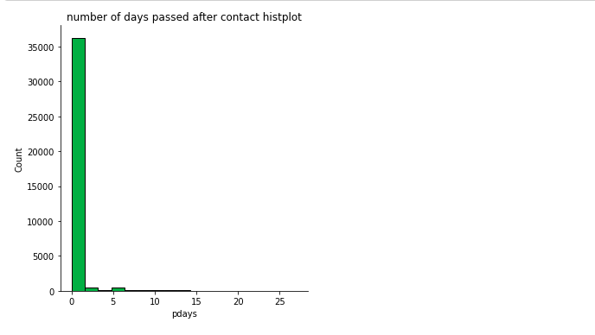
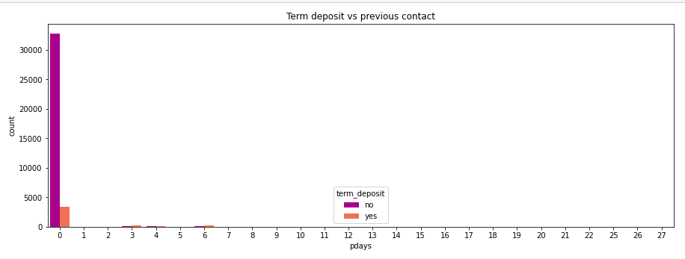
Days passed after the customer was previously contacted.
Both graphs show the number of days passed since the client was last contacted. It’s quite clear the number
of days passed for most clients is zero. And in the second graph, those whose number of days passed since they were lastly contacted is zero are the ones who accepted the bank’s product.

Slide 14
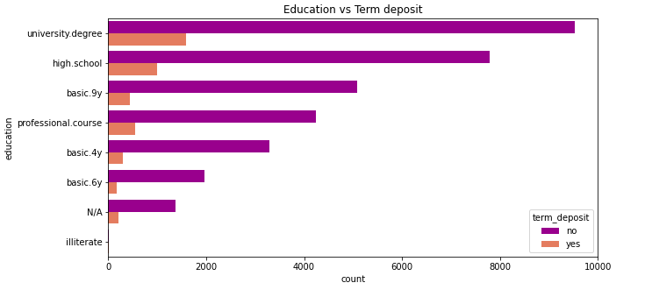
Education Variable analysis
Those whose education level at university degree were the mostly contacted customers.
Still they are ones who accepted to buy the bank’s product compared to the rest.
The illiterate were the least contacted people, still the least subscribers.

Slide 15
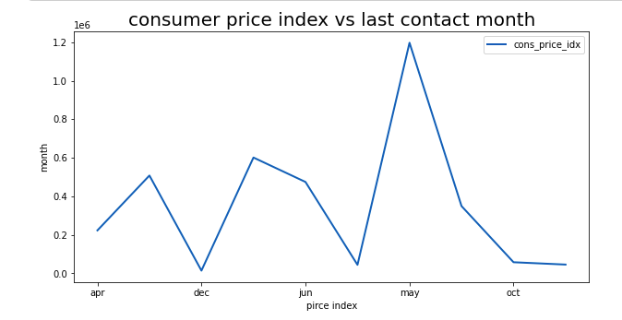
Consumer Price Index vs Last Contact Month
The month of May had the highest consumer price index
While the month of December had the lowest consumer price index.
It is in the same months that we had the highest number of subscribers and the least number too respectively.

Slide 16
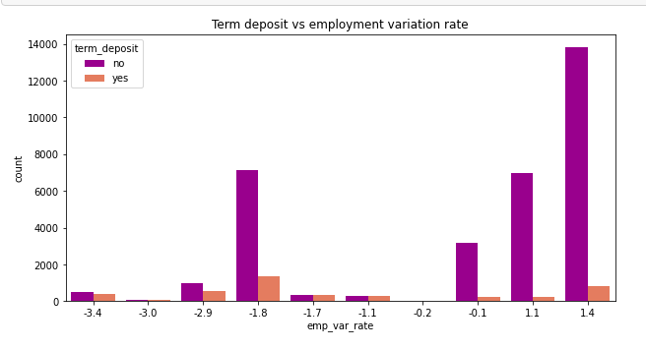
Employment Variation Rate Analysis
Those whose employment variation rate is 1.4 were the most contacted customers also the most people who rejected the product.
Those whose employment variation rate was -1.8 are the customers who accepted the product compared to the rest.

Slide 17
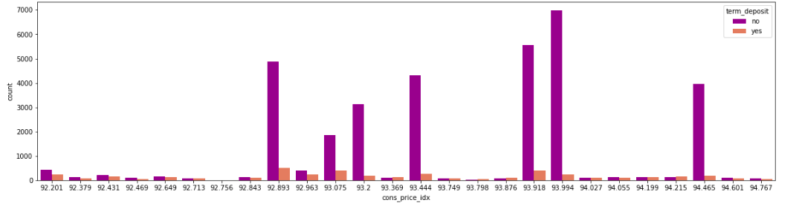
Consumer Price Index Analysis
High subscriptions were when the consumer_price_index 92.893 and 93.918

Slide 18
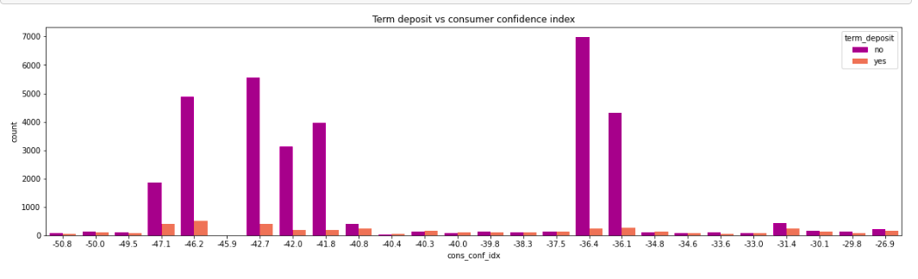
Consumer Confidence Index Analysis
Most customers agreed to buy the term deposit product when the consumer confidence index was -46.2

Slide 19
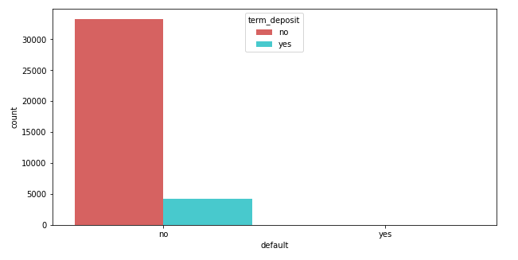
Credit in Default
Most customers reached had credit in default. Most rejected the bank’s product.

Slide 20
Models
This is a binary classification. Recommended models include
Logistic Regression
Decision tree classifier
Random forest classifier
Gradient boosting classifier
Artificial neural network(Sequential model)

Slide 21
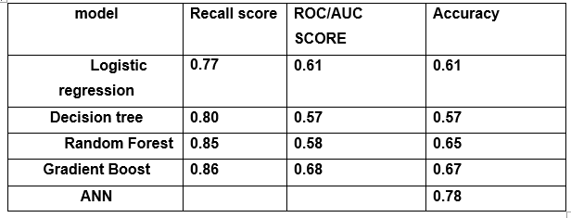
Model Perfomance
The best model to use is Gradient boast or Artificial Neural Network.

Slide 22
Recommendations
After the analysis of whether the customer will subscribe or not, this is what we would recommend.
Customers whose education level is at the university level should be targeted mostly. Their chances of buying the product is higher than other customers with a lower education level.
More customers should be contacted in the months of May, June, July, August but mostly May. One is likely to buy the product during this month.
Most customers who were contacted once accepted the product compared to those who were contacted more than once. So just a single contact is better than multiple contacts.
They should also target customers without personal loans with the bank. They are more likely to buy the product.

Slide 23
Thank You

